Slide 1
Qube-Servo 2 Curriculum Presentation
This presentation is intended to provide general content for any relevant presentations
The general real-world applications of the DC motor and pendulum experiments are highlighted
An overview of the curriculum topics is also presented
This material is subject to license and copyright agreements, and may only be used or reproduced as specified in that license agreement. You are free to incorporate this material into your curriculum for distribution to students as long as: a) the name Quanser Inc. is included for attribution and, b) the material is not used for commercial advantage or monetary compensation.

Slide 2
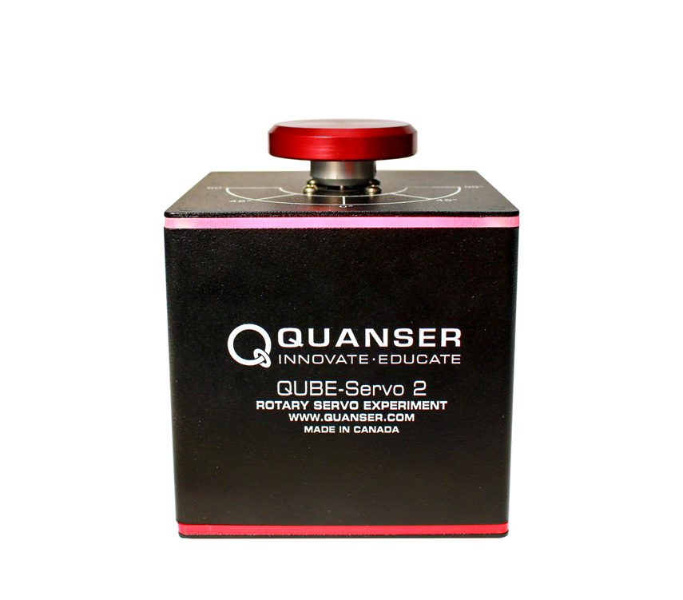
QUBE-Servo 2 DC Motor Experiment

Slide 3
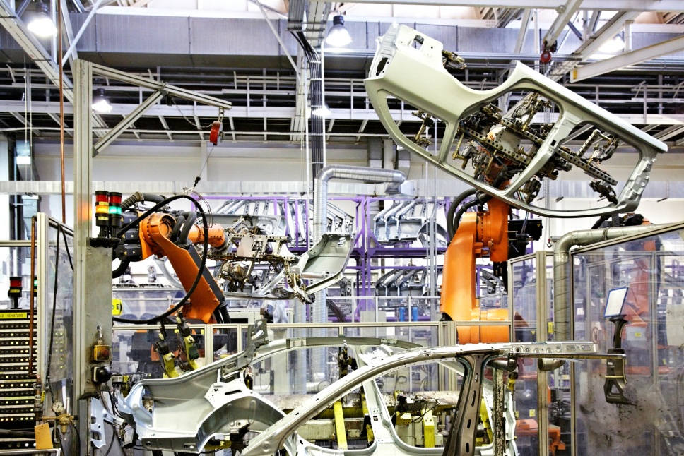
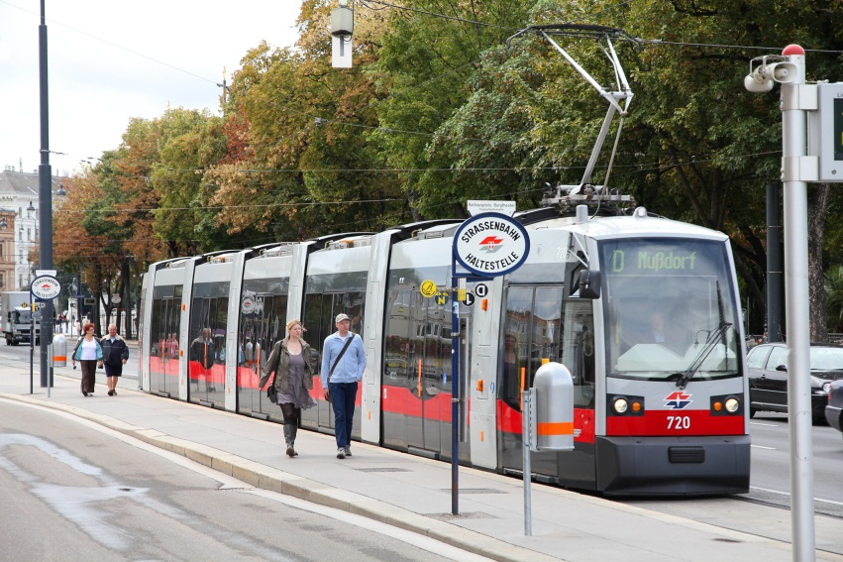


DC Motor Control

Slide 4
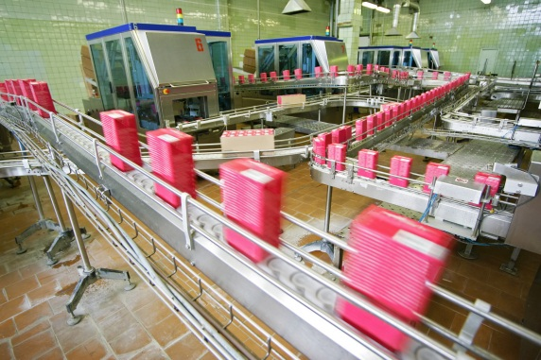
DC Motor Modeling
Used in many places in industry to ensure that a part has been produced within allowable tolerances

Slide 5
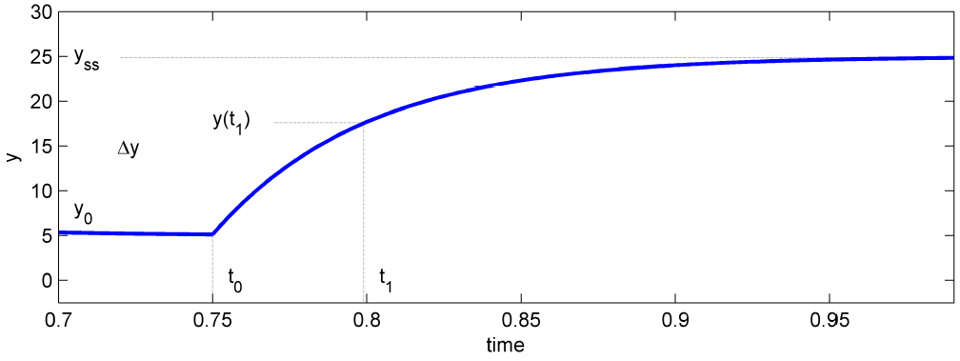
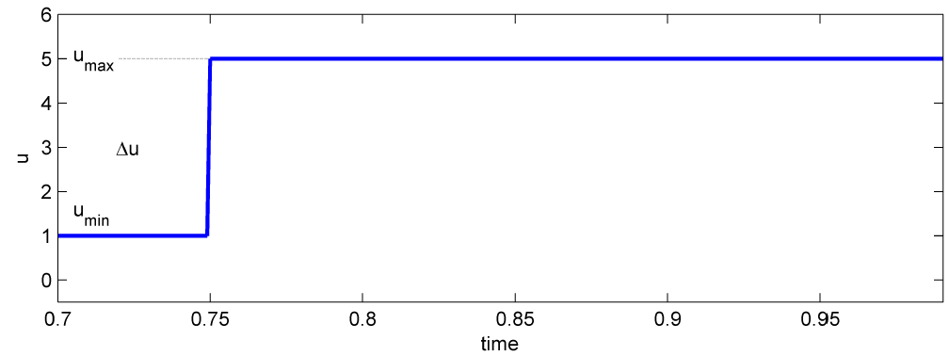
DC Motor Modeling
A bump test models the physics of the DC motor.
It is a simple test measuring the step response of a stable system.

Slide 6
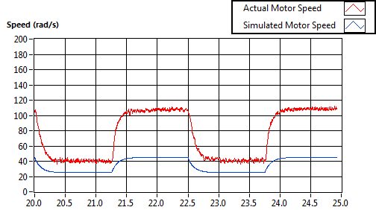
DC Motor Modeling

Slide 7
DC Motor Modeling
Modeling and validation is used in many applications and many places in industry.
Mathematical models are often used in manufacturing and system maintenance to ensure motors are operating within acceptable tolerances.

Slide 8
Motion Control
Mathematical models of the system can be obtained from:
First principles
Complementary experiments
A DC motor can be used to illustrate motion control.

Slide 9
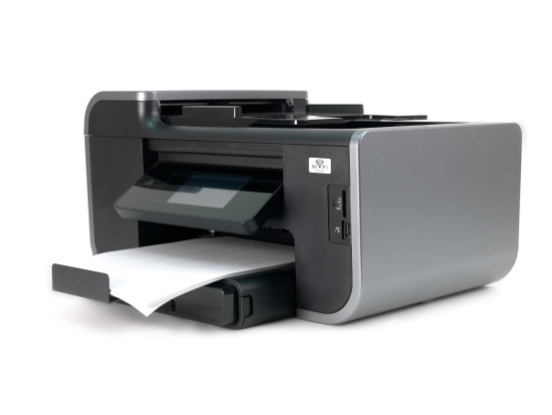
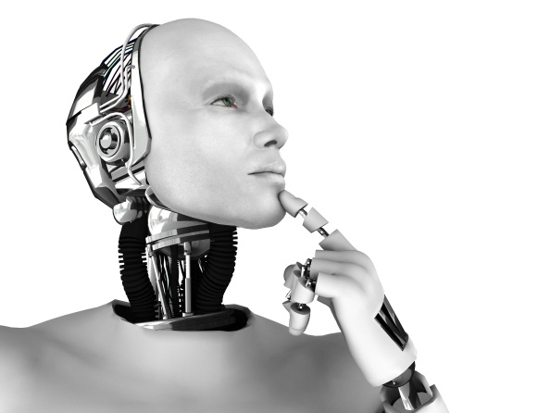

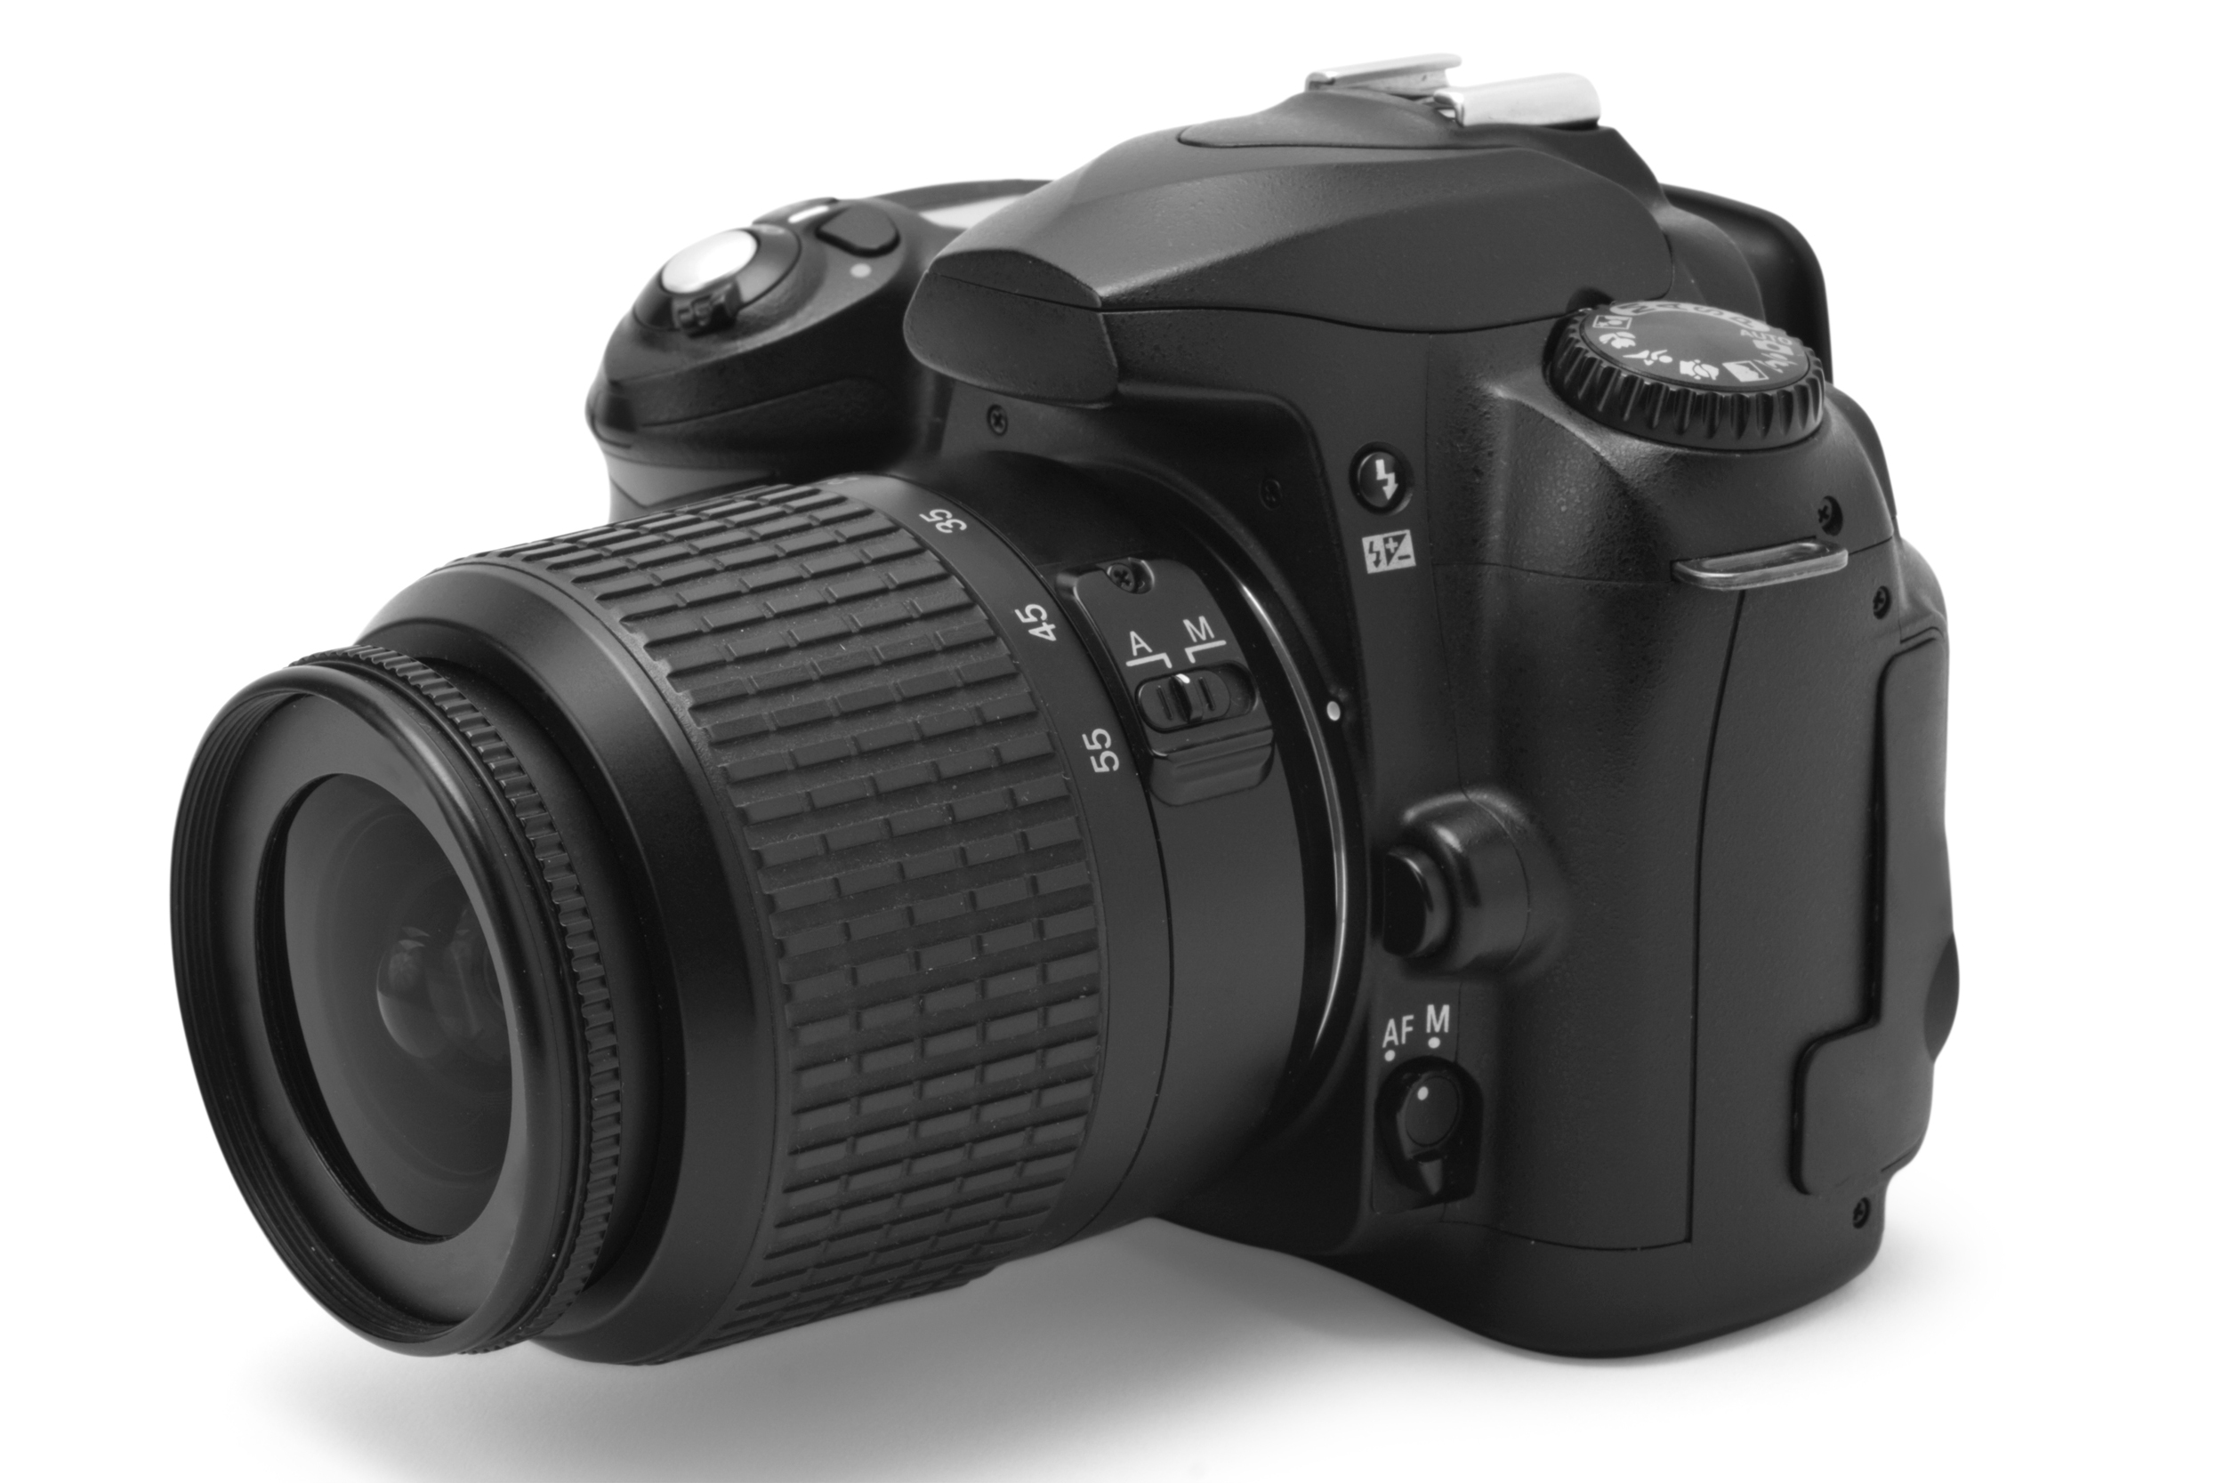
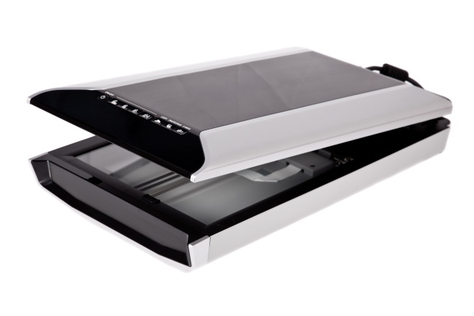

Motion Control

Slide 10
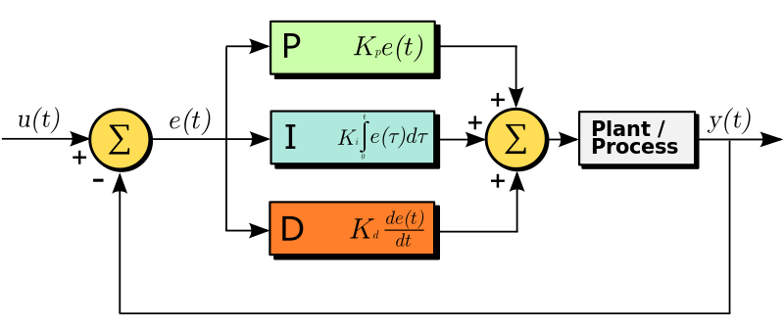
Feedback and PID Control

Slide 11
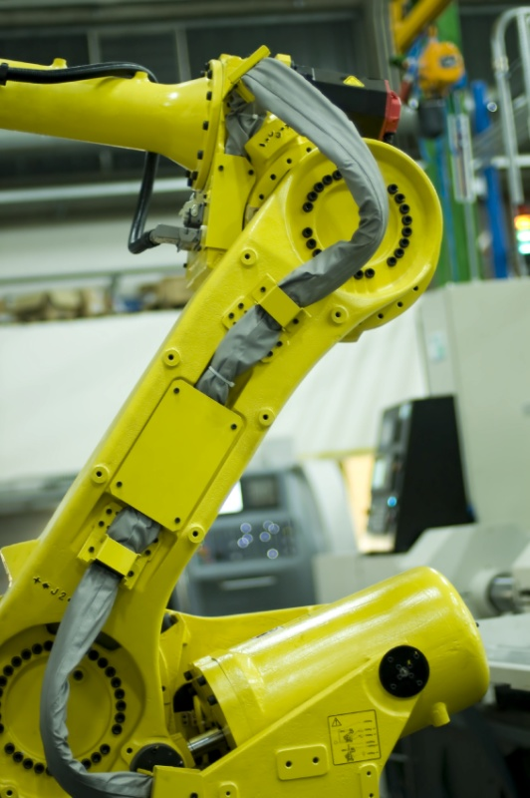
Feedback and PID Control
Feedback control makes corrective actions based on the difference between the desired and actual value.
Desired value: the cruise control setting
Actual value: the current speed of the car

Slide 12
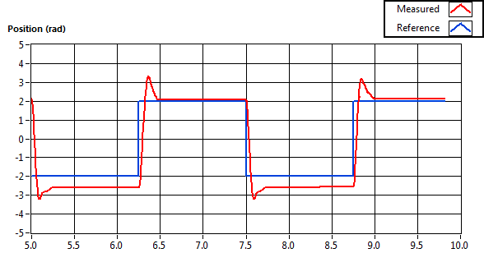
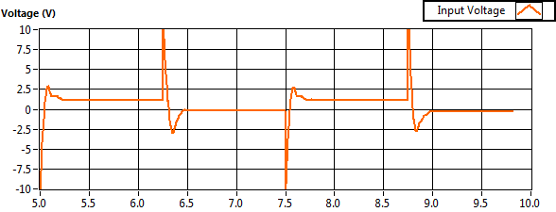
DC Motor Control Trainer Feedback
Feedback control tries to maintain the desired value.

Slide 13
Feedback Systems
Useful where an object must be positioned relative to another object.
Sensors take real-time measurements to compensate for the difference between where it is and where it should be.

Slide 14
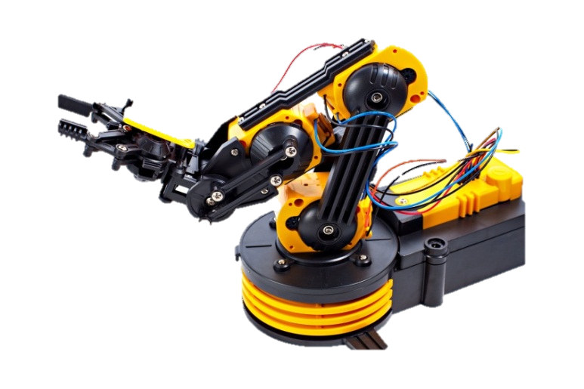
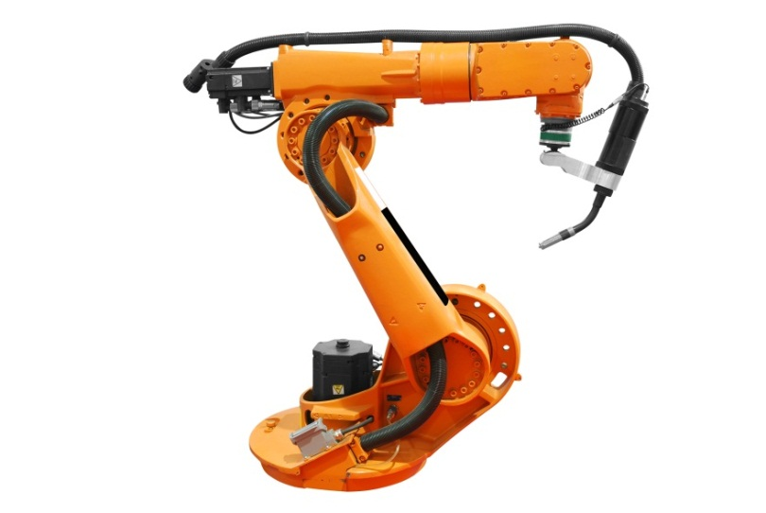
Feedback Systems
In robotics, PID control is used to precisely govern movements of different components.
Motor control and feedback loops can be used to achieve high levels of accuracy.

Slide 15

Speed Control
PID control is used in a wide array of industries.
Speed control is used extensively in transportation and electronics.

Slide 16
Position Control
The Position Control experiment continues using PID control.
Position control is used in a number of robotics applications, including automated assembly lines.

Slide 17
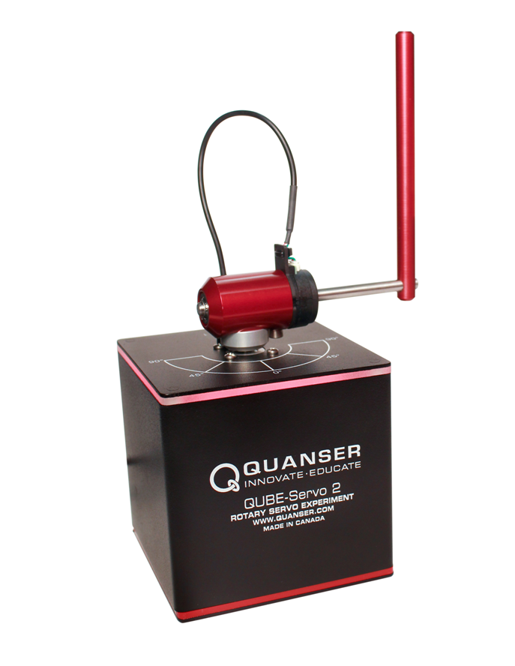
QUBE-Servo 2 Pendulum Experiment

Slide 18

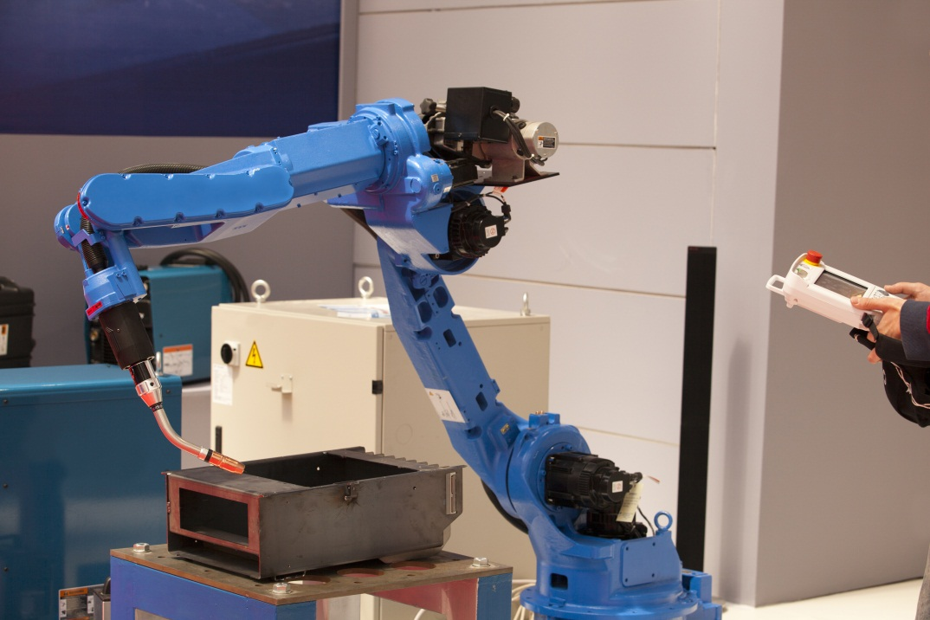
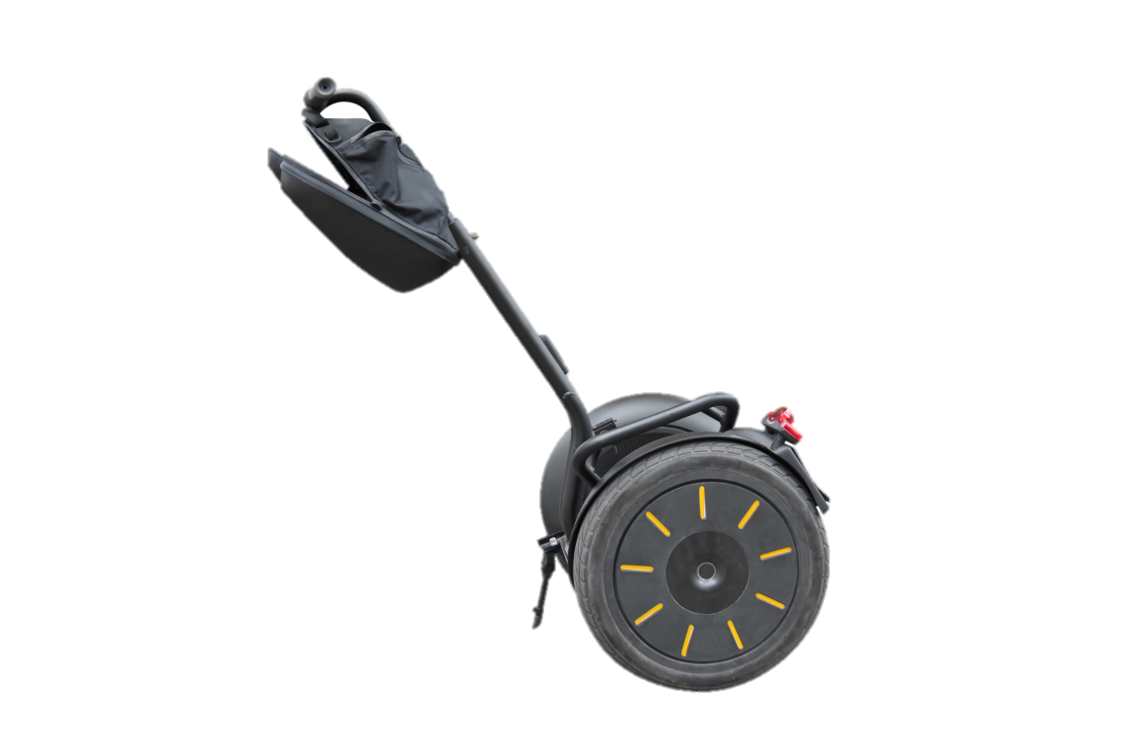
Rotary Inverted Pendulum

Slide 19
Modeling
To solve a control problem first investigate the physics of the system.
This can be achieved through modeling.
For example, we can simulate a crane swinging a load and investigate how to dampen the oscillation of the load.

Slide 20

Modeling Experiment
Used to develop strategies to compensate for the undesired physical limitations of a system, such as damping oscillations or overcoming friction

Slide 21
Stabilization Control
The Rotary Inverted Pendulum can be used to observe how a stabilization control system works.
The main goal of stabilization control is to provide smooth, stable motion while reacting to external stimuli.
Using PD control the inverted pendulum trainer can react to stimuli and maintain a vertical position.

Slide 22

Balance Control Implementation
Used in stabilization systems, such as rocket stabilization or traction control in vehicles, and the Segway® Personal Transporter

Slide 23
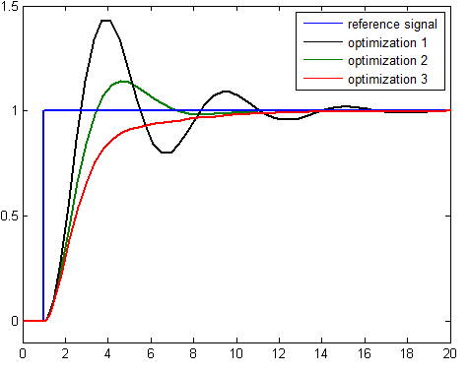
Balance Control Design Experiment
Investigates Control Optimization by using Linear Quadratic Regulator (LQR) theory
Used to minimize or maximize a certain criteria

Slide 24
Swing-Up Control
The Inverted Pendulum Trainer attempts to swing the pendulum up and keep it balanced.
The first part of this process controls the kinetic and potential energy of the system to swing the pendulum to a vertical position.
The second part of the process uses stabilization control to keep the pendulum balanced.

Slide 25
Swing-Up Control
Since achieving these tasks requires switching between two control systems it is called a hybrid controller.
Hybrid controllers are used when different phases of a process need different control types.

